Slide 1
ENSC 251 Final Project:
>Samin Moradkhan
>Ryan Martin
>Philip Nguyen
>Harry Lee

Slide 2
Project Management
PART I

Slide 3



//Communication/workflow 1/2
ZOOM
"Zoom was used for meetings"
"Tasks were assigned during meetings"
DISCORD
"updating group members on task progression"
"general communications that didn't warrant a meeting"
GITHUB
"all updates were pushed onto a github repository"

Slide 4
//Communication/workflow 2/2
"Weekly meetings related to project progress"
"established some light deadlines for when we needed certain parts done"

Slide 5
Using Linked Lists for Student Info
Part II

Slide 6
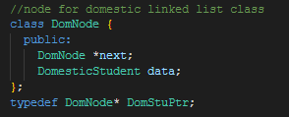
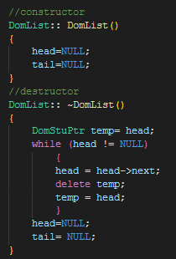
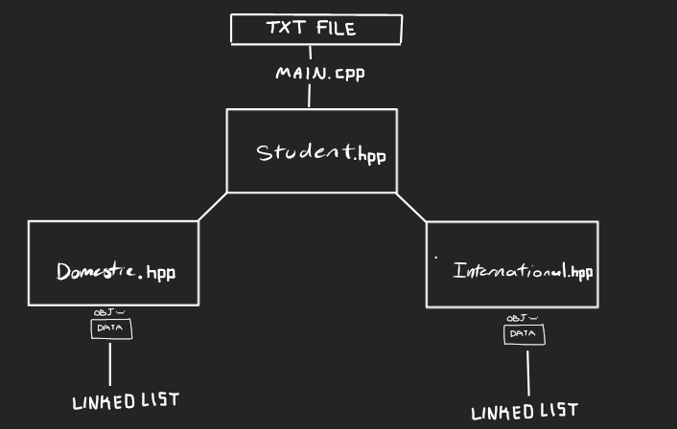
//Creating Linked List for Student Info 1/2
"Used prior class to collect student data"
"Transfer data from student objects to specified linked list class"

Slide 7
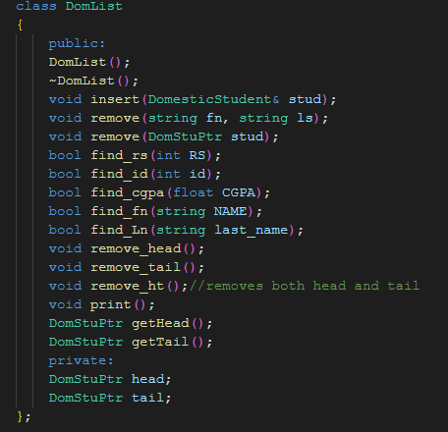
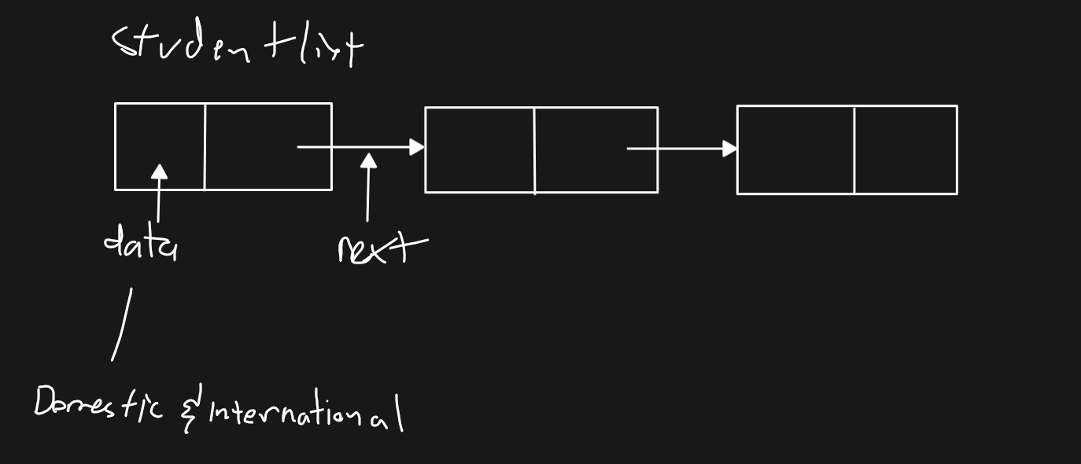
//Creating Linked List for Student Info 2/2
"functions to create/remove a linked list"
"functions to search for specific info"

Slide 8
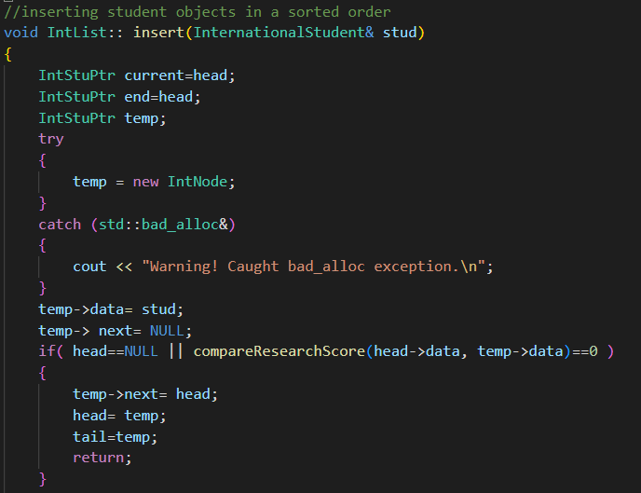
//Inserting Student Data into Linked List 1/2
"creates new node"
"bad_alloc: indicates memory allocation failure"
"temp->data holds student object data"
"if statement defines the first node of list"

Slide 9
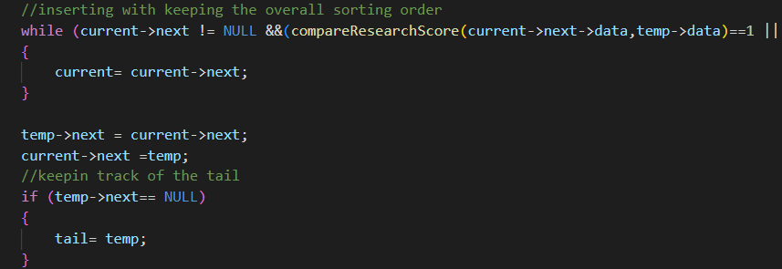
Inserting Student Data into Linked List 2/2
"while loop inserts the nodes in the sorted order"
"transverses down the list and compares with other node if not empty"
"link the 2 nodes together"
"if statement tracks the tail"

Slide 10
Features & "Innovations"
Part III

Slide 11
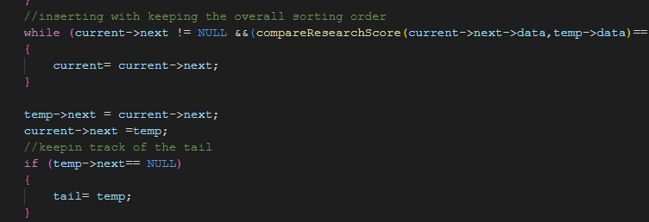
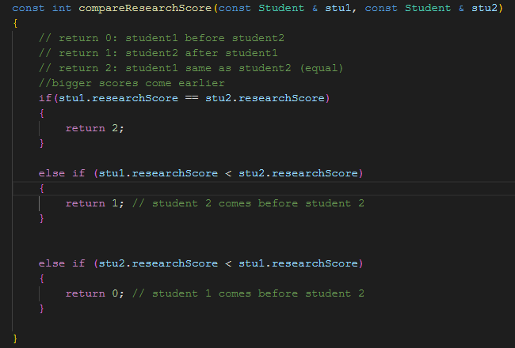
//Overall Sort "innovation"
"Data is sorted as it is being inserted into the list"
"Research_score => CGPA => keep order => Domestic > International"
"no need to create additional functions to sort the list"

Slide 12
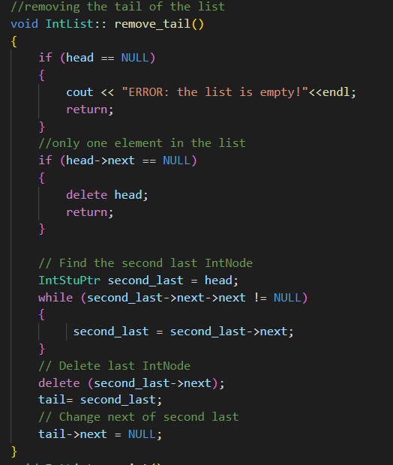
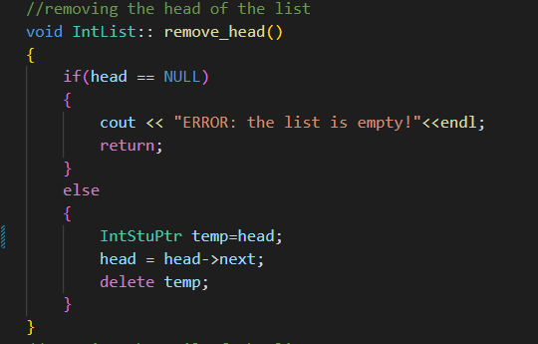
//Basic Linked List Functions
"remove head and tail functions"

Slide 13
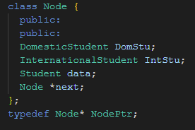
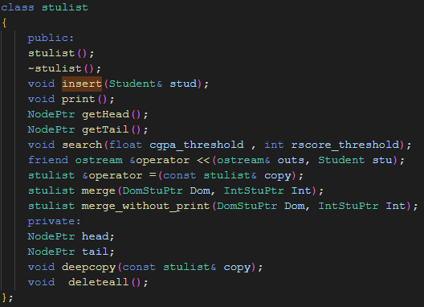
//Merging the 2 lists 1/2
"creates new list that w/ data from the domestic and international student lists"
"search functions for CGPA & Research score threshold"
"prints the merged list"
"deleteall: Deallocates memory"
"deep copy"

Slide 14
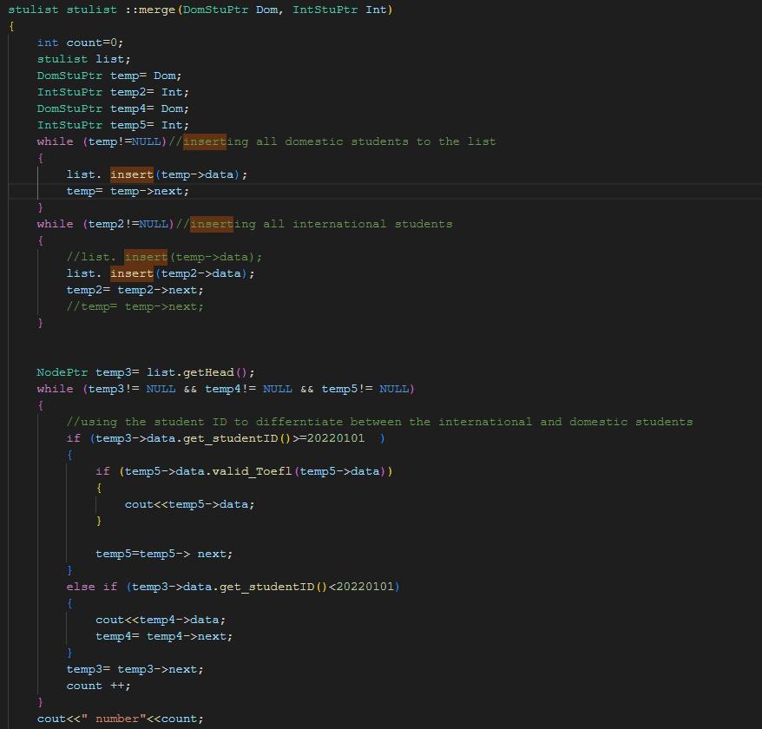
//Merging the 2 Lists 2/2 "innovation"
"used the student id to differentiate between domestic and international students"
"data is sorted as it is being inserted into the merged list"

Slide 15
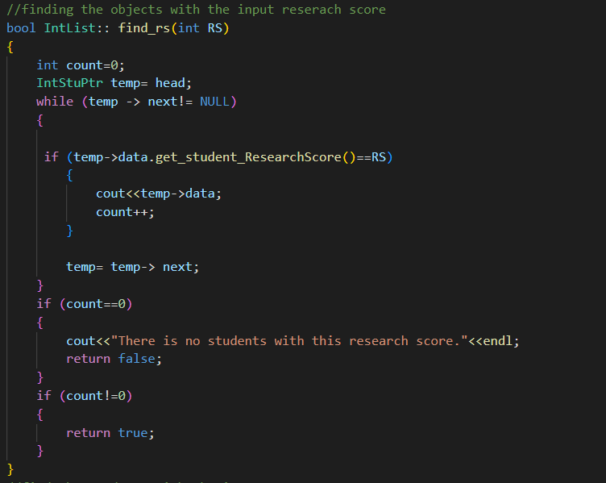
//International & domestic Student List Class
"code shared between the rest of the search functions"
""

Slide 16
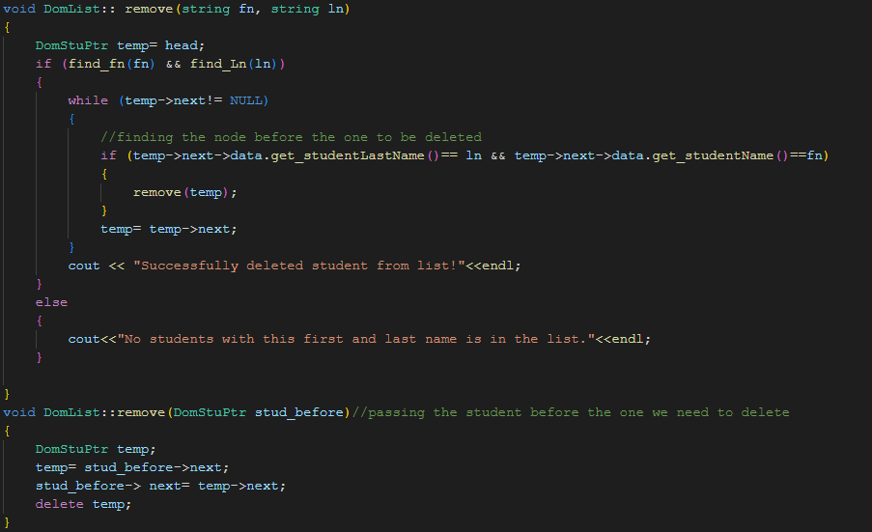
//Delete Student Object
"search for the node prior to the node we want to delete"
"pass that node to a remove function"
"helps make the remove function more efficient"

Slide 17
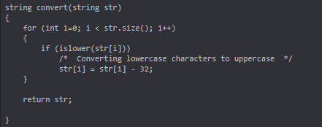
//Case Insensitive
"lowercase and uppercase characters are treated the same"
"If the letter is lowercase where it should be uppercase, it will convert the character"
"then compares to two strings to see if they are the same"

Slide 18
Algorithm Complexity Analysis
Part V

Slide 19
//Insert for Domestic and International
//Search
"Insert only calls compare functions to determine the sorted position of the object"
"compare is O(1) - comparing 2 elements at a time"
"traversing the list to right the correct position makes the function O(n)"
"searching for each category within the student object: first/last name, cgpa, research score, etc would all be O(n)"
"this is because we go through the list comparing the data with the input parameter (O(1)) for each element in the list"

Slide 20
//Student Deletion
//Delete head & tail
"Calling the function to search if user input parameter exist is O(n)"
"traversing the list to find the student to delete is also O(n)"
"the whole function would be O(2n) ~ O(n)"
"O(1) because we're always keeping track of where the head and tails are"

Slide 21
Testing/Program Walkthrough
Part IV

Slide 22
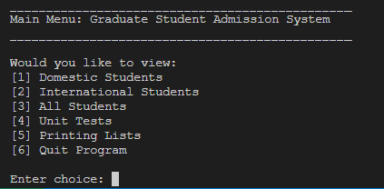

//Project User Interface 1/8
"Prompts user to choose an option"
"entering an invalid input will notify the user and allows them to try again"
"selections are made by typing an integer from 1-to-6"

Slide 23
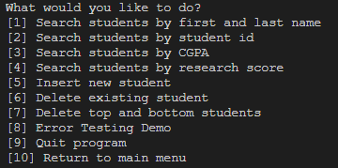
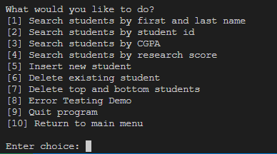
//Project User Interface 2/8
//options for international and domestic students
"Search functions for specific student info"
"function to add a new student"
"function to remove specified student"
"function to delete top and bottom students"
"error testing"
"exit program or return to menu"

Slide 24

//Project User Interface 3/8
//Search Functions
"searches for desired student information"
"prompts user to enter the information you want to find"
"program will print the student object associated with the input"
"program will then print the menu for user to choose new option"

Slide 25
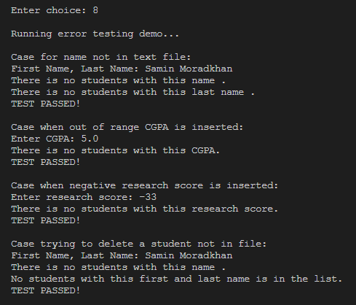
//Project User Interface 4/8:
"Error Testing"

Slide 26
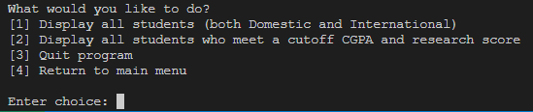
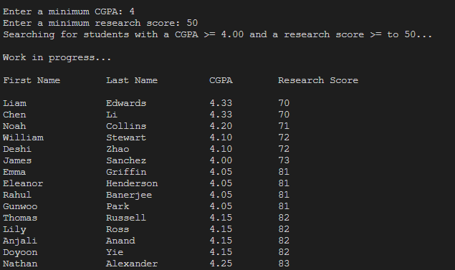
//Project User Interface 5/8

Slide 27
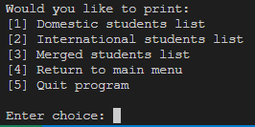
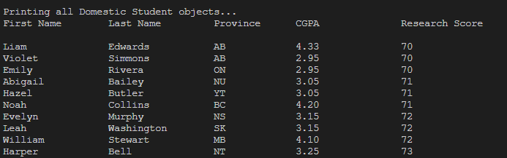
//Project User Interface 6/8

Slide 28
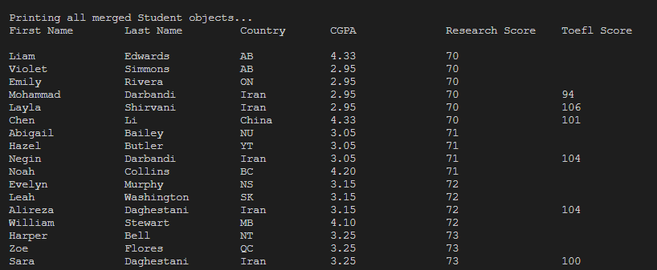
//Project User Interface 7/8

Slide 29
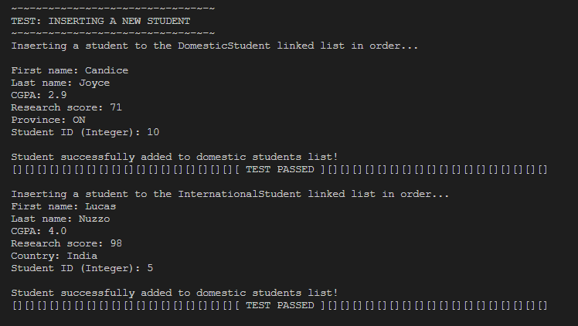
//Project User Interface 8/8

Slide 30

Thanks for Listening!
(but let's be real you all were sleeping o__o)

